Slide 1
VirtualBox networking

Slide 2
VirtualBox networking
Different options are available
Internal network
NAT
NAT network
Host only
Bridged
When do you use which? What are the benefits and drawbacks of using a specific VirtualBox networking solution?

Slide 3

VirtualBox networking Internal network
Host
Gateway / router
Internal IP: 10.10.10.1
External IP: 95.42.76.32
VirtualBox
Host interface
IP: 10.10.10.2
Guest
Internal IP:192.168.0.8
Internal IP:192.168.0.1
Guest
Internal IP:192.168.0.9
Other host processes

Slide 4
VirtualBox networking Internal network
VirtualBox makes available automatically a network interface inside a guest. If multiple guests share the same interface name, they are connected like a switch and can access each other.
A CLI can be used to configure the internal VirtualBox DHCP server (no GUI support)
Internet access or access to the host network interfaces is not available
The host cannot access guests

Slide 5
VirtualBox networking Internal network
Benefits:
Easy to use. Little configuration required
No VirtualBox virtual host network interface (device + driver) required
Guests can access each other
Secure (access from outside the host is not possible)
Drawbacks
The host can’t access the guests
Guests can’t access the host
Guests can’t access the internet
The VirtualBox internal DHCP server has no GUI support, only a CLI

Slide 6
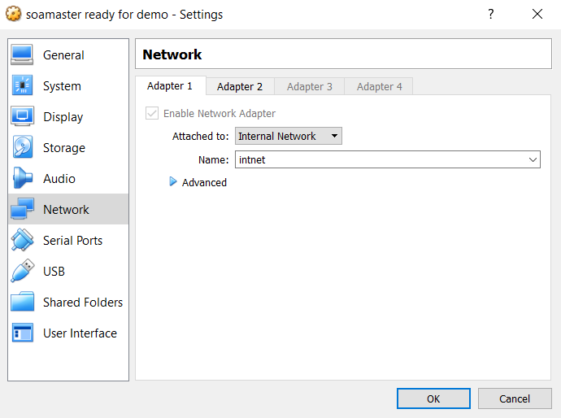
VirtualBox networking Internal network
Guest configuration

Slide 7
VirtualBox networking Network Address Translation
Host
Gateway / router
Internal IP: 10.10.10.1
External IP: 95.42.76.32
VirtualBox
Host interface
IP: 10.10.10.2
Guest
Internal IP:192.168.0.8
Virtual NAT router
Internal IP:192.168.0.1
External: host interface
Guest
Internal IP:192.168.0.9
Virtual NAT router
Internal IP:192.168.0.1
External: host interface
Other host processes

Slide 8
VirtualBox networking Network Address Translation
VirtualBox makes available automatically a single virtual isolated NAT router on a network interface inside a guest. Every guest gets his own virtual router and can’t access other guests.
DHCP (Dynamic Host Configuration Protocol) requests on the interface are answered with an IP for the guest and address of the NAT router as gateway. The DHCP server can be configured using a CLI (no GUI support).
The NAT router uses the hosts network interface. No specific VirtualBox network interface needs to be created. External parties only see a single host interface.
The NAT router opens a port on the hosts interface. The internal address is translated to the hosts IP. The request to the destination IP is done. The response is forwarded back towards the guest (a table of external port to internal IP is kept by the router).
Port mappings can be made to allow requests to the host on a specific port to be forwarded to the guest.

Slide 9
VirtualBox networking Network Address Translation
Benefits:
Easy to use. Little configuration required
Isolated. Every guest their own virtual router
No VirtualBox virtual host network interface (device + driver) required
Internet access
Fixed IP possible
Drawbacks
Guests can’t access each other or the host
The virtual NAT router DHCP server can be configured using a CLI only
To access the guest from the host requires port forwarding configuration and might require an entry in the hosts hosts file for specific web interfaces

Slide 10
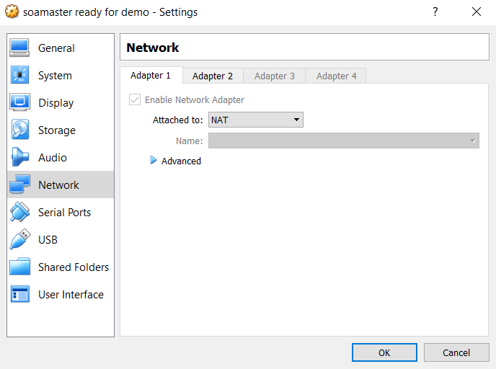
VirtualBox networking Network Address Translation
Guest configuration

Slide 11
VirtualBox networking Network Address Translation. NAT network
Host
Gateway / router
Internal IP: 10.10.10.1
External IP: 95.42.76.32
VirtualBox
Host interface
IP: 10.10.10.2
Guest
Internal IP:192.168.0.8
Virtual NAT router
Internal IP:192.168.0.1
External IP: host interface
Guest
Internal IP:192.168.0.9
Other host processes
11

Slide 12
VirtualBox networking Network Address Translation. NAT network
VirtualBox makes available a virtual NAT router on a network interface for all guests using the NAT network. Guests can access each other. The NAT network needs to be created.
DHCP (Dynamic Host Configuration Protocol) requests on the interface are answered with an IP for the guest and address of the NAT router as gateway. The DHCP server can be configured.
The NAT router uses the hosts network interface. No specific VirtualBox network interface needs to be created. External parties only see a single host interface.
The NAT router opens a port on the hosts interface. The internal address is translated to the hosts IP to a specific port per host. The request to the destination IP is done. The response is forwarded back towards the guest (a table of external port to internal IP is kept by the router).
Port mappings can be made to allow requests to the host on a specific port to be forwarded to a guest.

Slide 13
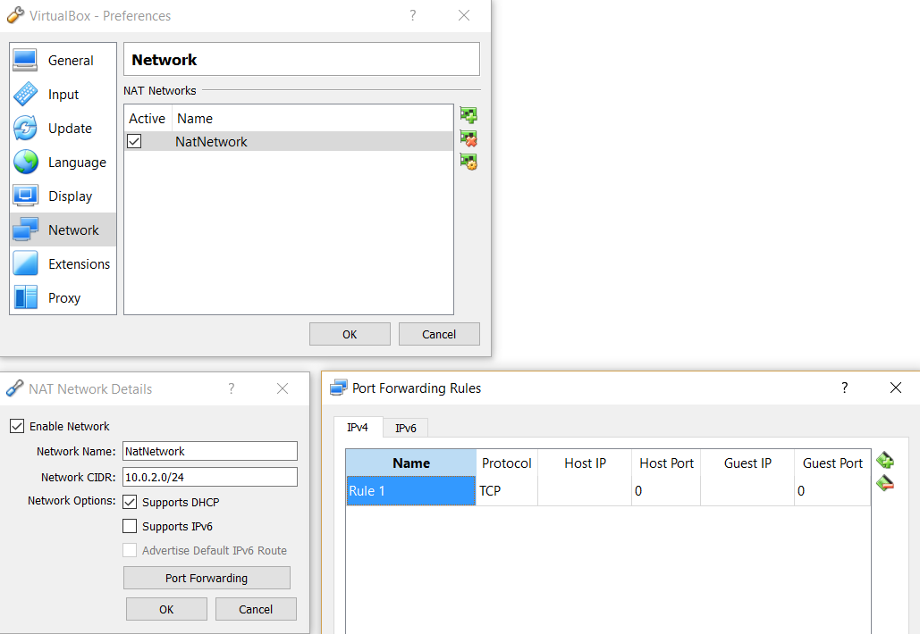
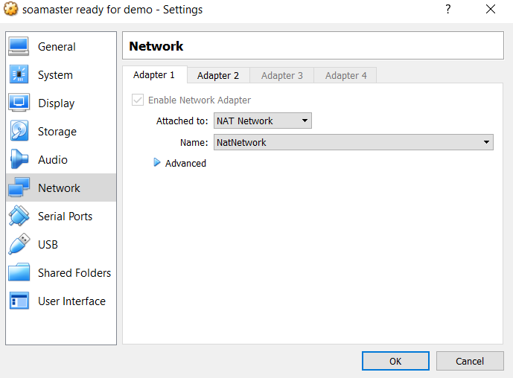
VirtualBox networking Network Address Translation. NAT network
VirtualBox configuration
Guest configuration

Slide 14
VirtualBox networking Network Address Translation. NAT network
Benefits:
Guests can access each other
No VirtualBox virtual host network interface (device + driver) required
DHCP server can be configured using the GUI
Internet access
Fixed IP possible
Drawbacks
To access the guest from the host requires port forwarding configuration and might require an entry in the hosts hosts file for specific webinterfaces
Requires additional VirtualBox configuration to define the network / DHCP server

Slide 15
VirtualBox networking Host only
Host interface
IP: 192.168.0.1
Host
Gateway / router
Internal IP: 10.10.10.1
External IP: 95.42.76.32
VirtualBox
Guest
Internal IP:192.168.0.100
Guest
Internal IP:192.168.0.101
Host interface
IP: 10.10.10.2
Other host processes
15
15

Slide 16
VirtualBox networking Host only
VirtualBox creates a host interface (a virtual device visible on the host). This interface can be shared amongst guests. Guests can access each other.
DHCP (Dynamic Host Configuration Protocol) requests on the interface are answered with an IP for the guest and address of the Host only adapter. The DHCP server can be configured using the VirtualBox GUI
The virtual host interface is not visible outside of the host. The internet cannot be accessed via this interface from the guest.
The host can access the guests by IP. Port mappings are not needed.

Slide 17
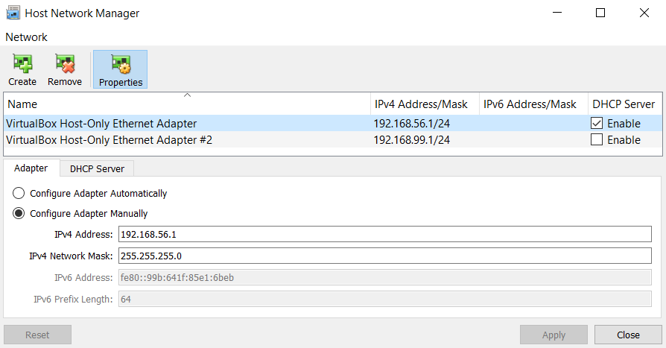
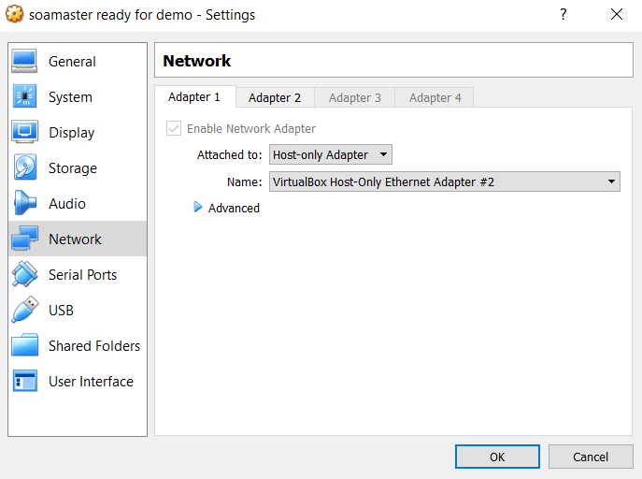
VirtualBox networking Host only
VirtualBox configuration
Guest configuration

Slide 18
VirtualBox networking Host only
Benefits:
Guests can access each other
You can create separate guest networks
DHCP server can be configured using the GUI
Fixed IP possible
Drawbacks
To access the guest from the host requires port forwarding configuration and might require an entry in the hosts hosts file for specific webinterfaces
Requires additional VirtualBox configuration to define the network / DHCP server
VirtualBox virtual host network interface (device + driver) required
No internet access

Slide 19
VirtualBox networking Bridged
Host
Gateway / router
Internal IP: 10.10.10.1
External IP: 95.42.76.32
VirtualBox
Host interface
IP: 10.10.10.2 (host)
IP: 10.10.10.3 (Guest 1)
IP: 10.10.10.4 (Guest 2)
Guest 1
Guest 2
Other host processes

Slide 20
VirtualBox networking Bridged
The guest uses a host interface. On the host interface a net filter driver is applied to allow VirtualBox to send data to the guest. This requires a so-called promiscuous mode to be used by the adapter. Promiscuous mode means the adapter can have multiple MAC addresses. Most wireless adapters do not support this. In that case VirtualBox replaces the MAC address of packages which are visible to the adapter.
An external DHCP server is used. Same way the host gets its IP / gateway. No additional configuration required. It might not work if the DHCP server only allows registered MACs (some company networks)
Easy access. The guest is directly available from the network (every host) the host is connected to. Port mappings are not required. The host can access the guests by IP. Guests can access the host by IP.

Slide 21

VirtualBox networking Bridged
Guest configuration

Slide 22
VirtualBox networking Bridged
Benefits:
Guests can access each other
Host can access guests and guests can access the host. Anyone on the host network can access the guests
No virtual DHCP server needed
Easy to configure / use
Same access to internet as the host has
Drawbacks
Guests can’t be split into separate networks (not isolated)
Sometimes doesn’t work; dependent on external DHCP server and ability to filter packets on a host network interface. Company networks might block your interface
No easy option for a fixed IP since host network is a variable
Not secure. The guest is exposed on the hosts network

Slide 23
VirtualBox networking Overview
 | Guest → Host | Guest ← Host | Guest1 ↔ Guest2 | Guest → Internet | Guest ← Internet
Host-only | + | + | + | – | –
Internal | – | – | + | – | –
Bridged | + | + | + | + | +
NAT | – | Port forwarding | – | + | Port forwarding
NAT Network | – | Port forwarding | + | + | Port forwarding

Slide 24
VirtualBox networking Case 1: ELK stack for learning purposes
I’m trying out the new version of the ELK stack (Elasticsearch, Logstash, Kibana)
Requirements:
I do not require internet access inside the guest
I want to access my guest from my host
I do not want my guest to be accessible outside of my host
I do not want to manually configure port mappings
Which networking solution should I choose?
Solution: Host only adapter

Slide 25
VirtualBox networking Case 2: SOA Suite for a security workshop
I’m using Oracle SOA Suite for a security workshop SOA Suite consists of 3 separate VMs, DB, Admin Server, Managed Server
Requirements:
The VMs require fixed (internal) IPs
The VMs need to be able to access each other
Course participants need to call my services from the same network
I only want to expose specific ports
Which networking solution should I choose?
Solution: NAT network or NAT + Host only

Slide 26
VirtualBox networking Case 3: Distributing a VM for a course
I’ve created an Ubuntu / Spring Tool Suite VM for a course. The VM will be distributed to participants.
Requirements:
The VM to distribute requires internet access. During the course several things will need to be downloaded
I am unaware of the VirtualBox created interfaces present on the host machines and don’t want the participants to manually have to select an adapter
I want the participants to do as little networking configuration as possible. VirtualBox networking is not the purpose of this course.
Which networking solution should I choose?
Solution: NAT

Slide 27
VirtualBox networking Case 4: Running a server inside a VM
I’ve created a server inside a VM which hosts an application.
Requirements:
The MAC of the VM is configured inside the routers DHCP server so it will always get the same IP. Use the external DHCP server to obtain an IP
The application will be used by (and thus needs to be accessible for) different people on the network.
The application uses many different ports for different features. These ports change regularly. Some features use random ports. Manual port mappings are not an option
The application accesses different resources (such as a print server) on the hosts network
Which networking solution should I choose?
Solution: Bridged

